Slide 1
Finding frequent users based on demographic details
CKME 136 Capstone Project
Josephine Choi
500-494-464

Slide 2
The dataset
The dataset
About
Plan
Available through San Franciso Open Data
Also available through Kaggle
Contains 42000+ patron records of San Francisco Public Library (SFPL), , with fifteen variables, including age range, home library code, year patron registered, total renewals and total checkouts in the period from 2003 to 2016.
To use total checkouts and total renewals - as independent variables, turning this into a classification problem: how to identify frequent users of the library based on demographic data?

Slide 3
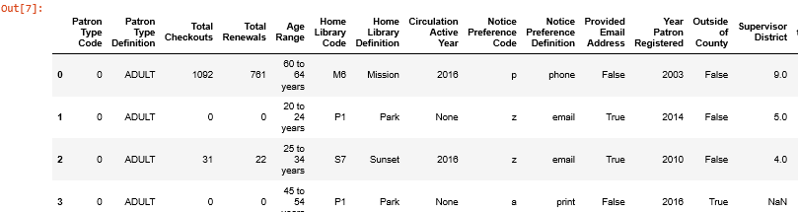
Head

Slide 4
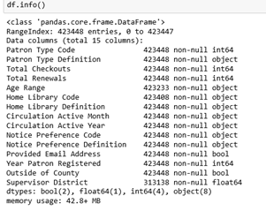
df.info

Slide 5
Add the classifier (decide the threshold for frequent and infrequent)
Evaluation
Initial Clean up and inspection
Clean up
EDA
Manipulation
Modeling
Evaluation
Exploratory Data Analysis and Literature Review
Modeling and Prediction

Slide 6
Exploratory Data Analysis

Slide 7
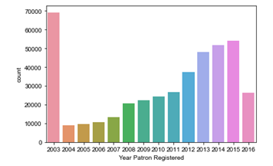
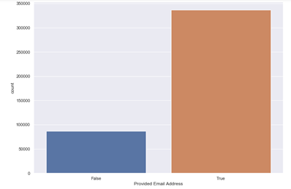
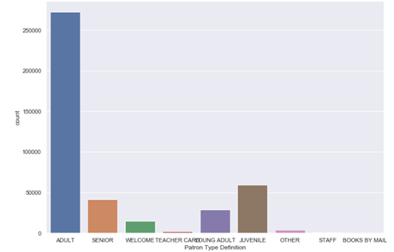
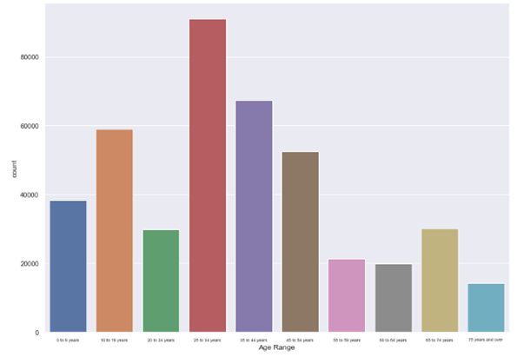
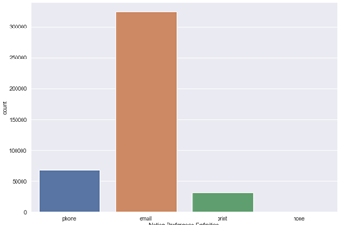
Categorical Variables

Slide 8
Challenges
Challenge 1
Challenge 2
Challenge 3
Duplicated variables: Patron Type Definition, Notice Preference Definition, and Home Library Definition interpret the Patron Type Code, Notice Preference Definition, and Home Library Code
Missing data:
Supervisor District, Age Range, and Home Library Code - have missing values. Supervisor District is missing in approx. 25% of the dataset.
Imbalanced Data:
Only 15.5 % users are classfied as “frequent users”

Slide 9

Calculate Total Checkouts (CKO) and Average CKO

Slide 10
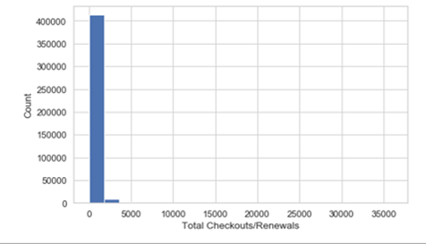
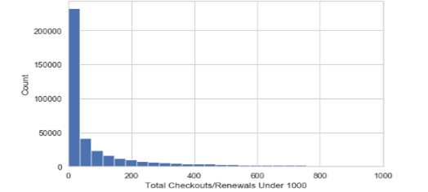
Total Checkouts

Slide 11
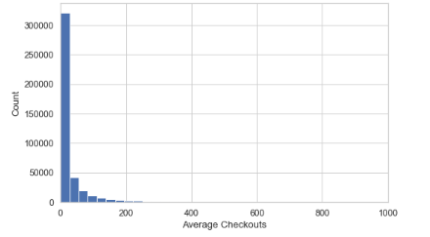
Average Checkouts

Slide 12
Threshold
Average CKO > 50 = frequent users

Slide 13
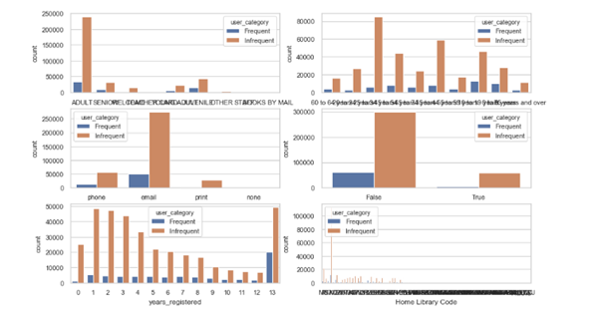
EDA based on frequent/infrequent category

Slide 14
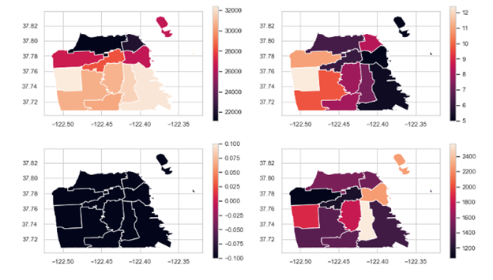
Explore average ckos using Geopanda

Slide 15
Imbalanced Data
Oversampling minority class with SMOTE

Slide 16
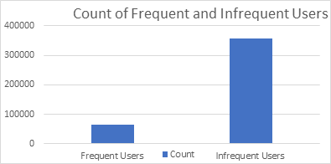
Counter({0: 357926, 1: 65522})

Slide 17
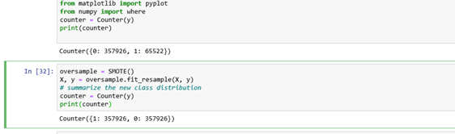
Using SMOTE to oversample minority class

Slide 18
Modeling and Prediction

Slide 19
Steps
- Create new variables, for instance, calculate the number of years the patrons have a library card ( 2016 minus “Year Patron Registered” = “years_registered”), average annual checkouts (‘avg_cko’)
- Turn categorical variables, such as Age Range, into numerical variable using median. Turn some categorical variables into Boolean (e.g. Provide email address, outside county)
- Fill missing values in the variable “supervisory district” with numerical value ‘12’. The records with null values could be because these users have no fixed address, and hence it can be valuable information
- -

Slide 20
Steps (cont’d)
Based on average annual checkouts, identify the users with more than 50 checkouts as ‘frequent’ (1). The rest is ‘infrequent’ (0).
Create dummy data using data_dum. Discard the first column.
Apply SMOTE by using Imlearn in Python to oversample the minority class.
Apply the three algorithms, random forest, logistic regression, and KNN.
Evaluate the result with ten-fold cross validation using mean ROC AUC (mean of the area under the ROC curve.

Slide 21
Results

Slide 22
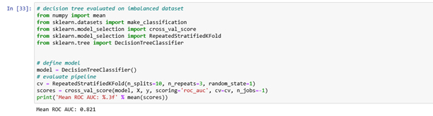
Random Forest

Slide 23
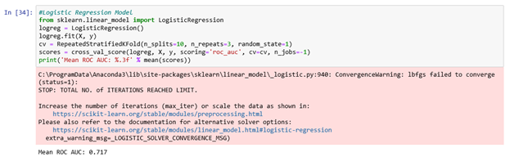
Logistic Regression

Slide 24
KNN

Slide 25
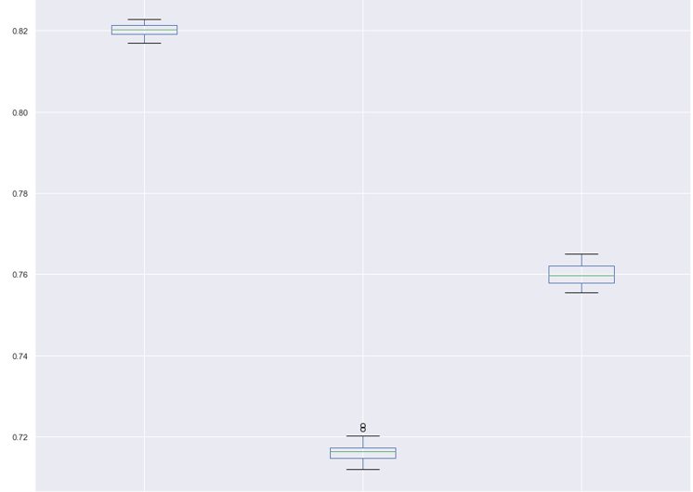
Boxplot

Slide 26
Questions ?

Slide 27
jochoi@ryerson.ca
https://github.com/josiechoi/Ryerson_capstone_library_usage

